Slide 1
The Box Model
Tutorial #22

Slide 2
OBJECTIVE

Slide 3
Objective
You should walk away from this tutorial with a general idea of how web pages are laid out. Under no circumstances should you expect to be an expert with this material after one tutorial. You will need to practice using it often.

Slide 4
TEXTPLANATION

Slide 5
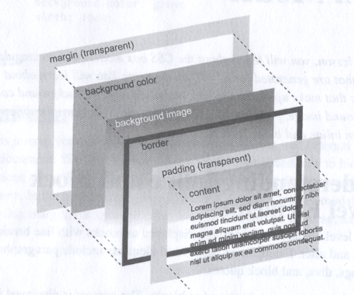
Textplanation
HTML elements are laid out on screen in a layered model called the Box Model. Each graphical piece added to the element has its place in the model.

Slide 6
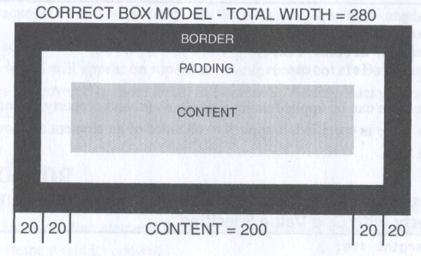
Textplanation
The width of an element is more than just the width of the content. When you set the width using CSS, you must keep in mind the fact that both the border and the padding take up space.

Slide 7
Textplanation
When you set the width of an element, that width is for the content only. When you alter the width of the padding or the border, that width is for the padding or the border only. The total width of the element includes all three.

Slide 8
Textplanation
With an understanding of the box model, you can begin to position your elements in ways so they won’t look awkward at certain resolutions and they won’t get in the way of other elements.

Slide 9
Textplanation
The position property defines how an element can be placed on the screen. The 4 different position values are:
static
relative
absolute
fixed

Slide 10
Textplanation
Static is the default positioning for all elements. An element with static positioning is placed on screen in the next available space as determined by its position in the code.

Slide 11
Textplanation
Relative positioning means that you can adjust the position of the element using left, top, right, and bottom. These values, however, are not specific to places on the screen. Instead, they place an element relative to where it would be if its positioning were static.

Slide 12
Textplanation
Fixed positioning allows you to set a left, top, right, and/or bottom position for the element based on the window. This is very different from relative. The measurement values provided when the position is fixed are exact positions on the screen.

Slide 13
Textplanation
Be aware that giving an element a fixed positioning removes it from its static context. Other elements cannot use it as a point of reference and therefore may overlap.

Slide 14
Textplanation
Absolute positioning allows you to set a left, top, right, and/or bottom position for the element based on the first ancestor that does have static positioning. This differs from fixed in that the browser will check the parent elements of an absolute element. If there are no parent elements without static positioning, the absolute element will be positioned based on the document.

Slide 15
CONSTRUCTION

Slide 16
Construction
Create a folder somewhere on your drive and label it The Box Model.
Open up notepad++.
Save the empty file to your folder and name the file “index.html”.
All first pages on a website are called index.
As you go through the images of the construction, pay close attention to the results. Test it often so that you can see the different effects of positioning.

Slide 17
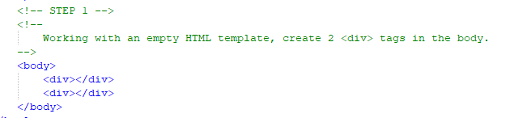
Construction

Slide 18
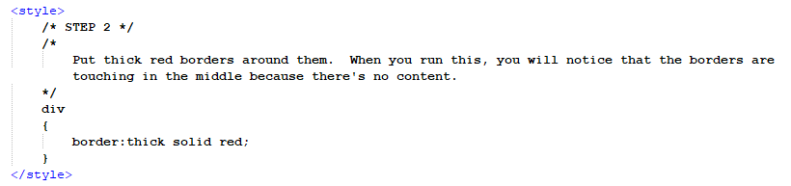
Construction

Slide 19
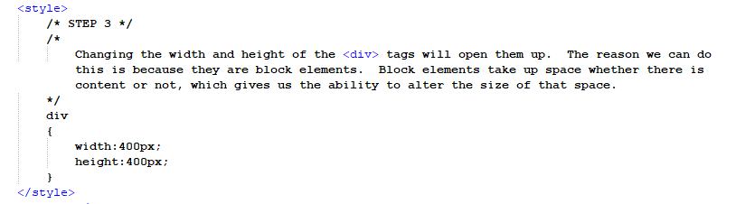
Construction

Slide 20
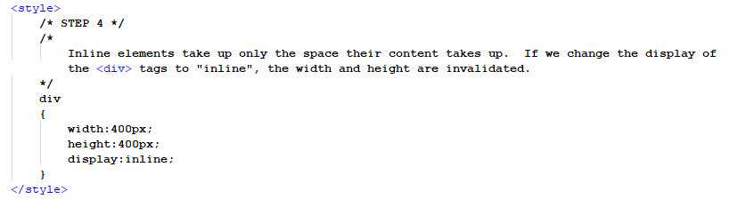
Construction

Slide 21
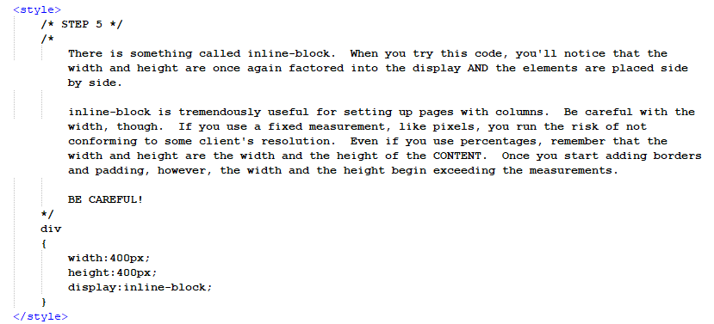
Construction

Slide 22
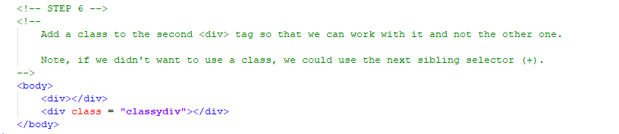
Construction

Slide 23
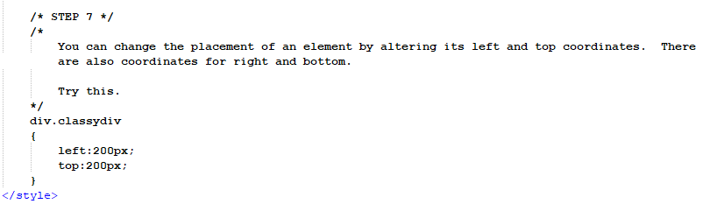
Construction

Slide 24
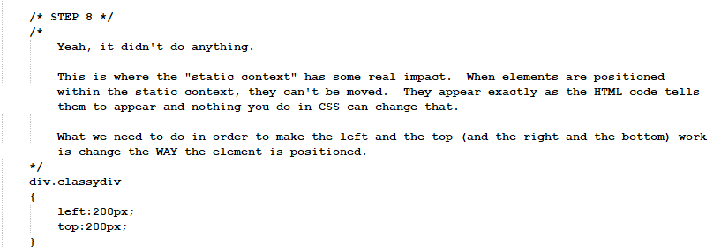
Construction

Slide 25
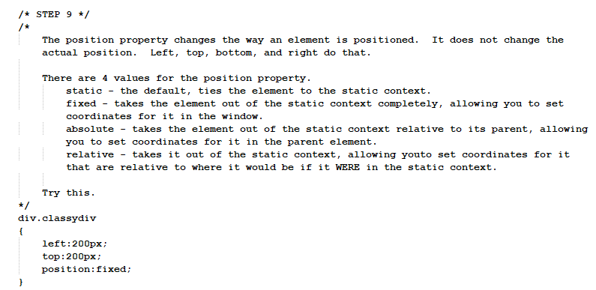
Construction

Slide 26
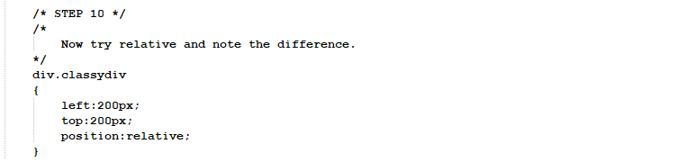
Construction

Slide 27
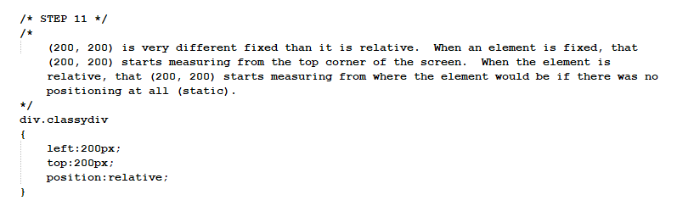
Construction

Slide 28
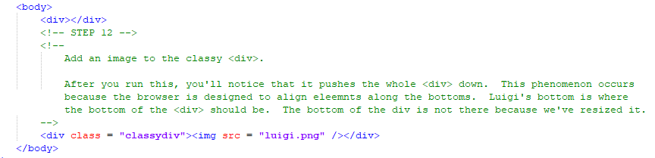
Construction

Slide 29
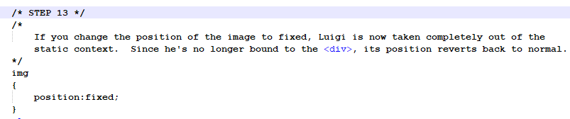
Construction

Slide 30
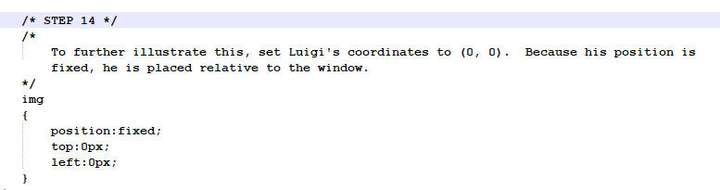
Construction

Slide 31
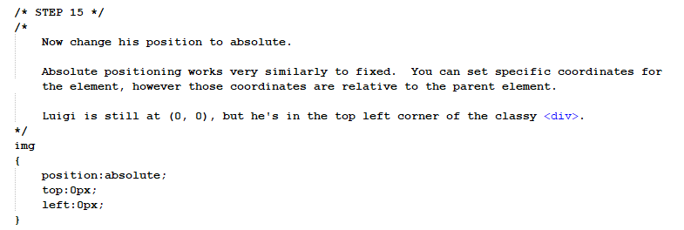
Construction

Slide 32
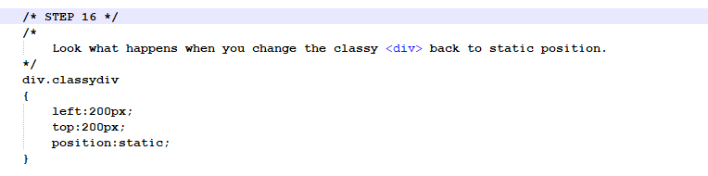
Construction

Slide 33
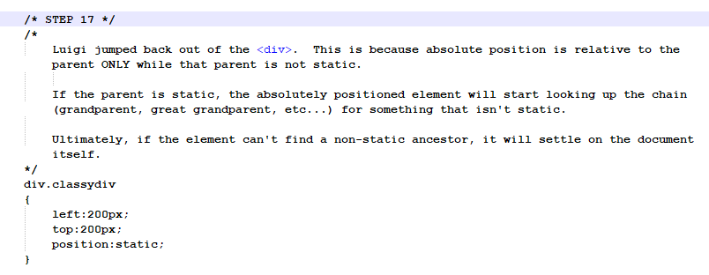
Construction

Slide 34
A DEEPER MEANING

Slide 35
A Deeper Meaning
I’m a fan of saying that you can program just about anything you can visualize.

Slide 36
A Deeper Meaning
I believe that.

Slide 37
A Deeper Meaning
I really do.

Slide 38
A Deeper Meaning
But moving things around on screen is a lot harder than it looks. There were many times over my years of web design that I thought I understood something, particularly something about the Box Model, and had to re-educate myself.

Slide 39
A Deeper Meaning
Always remember that your screen resolution is not everyone else’s screen resolution.

Slide 40
A Deeper Meaning
Always remember that what you code, you do not code for just yourself.

Slide 41
A Deeper Meaning
Always test your code on multiple resolutions.

Slide 42
A Deeper Meaning
And always remember that, when you use percentage as a measurement, that measurement has to be a percentage of something. If you don’t know what that something is, then you may be creating a monster.

Slide 43
FAQ

Slide 44
FAQ
Why shouldn't I always use absolute or fixed positioning and place my elements exactly where I want them?
Fixed and absolute positioning are very enticing, but they only really give the illusion of control. Aside from wrecking the flow of your page by taking elements out of the static context, the position you see on your screen may be very different on someone else’s screen. Designing web pages is an art as much as a science. You need to build something adaptable and fixed and absolute positioning are the furthest thing from it.

Slide 45
ACTIVITY

Slide 46
Activity Title
There is no activity for this tutorial. You will use it in everything you write. In fact, you’ve already been using it. Maybe something you designed previously didn’t fit just right onto the screen. Maybe now you know why.

